Slide 1
VISUVALIZATION TOOLS
AI
Enhanced insights presentation

Slide 2
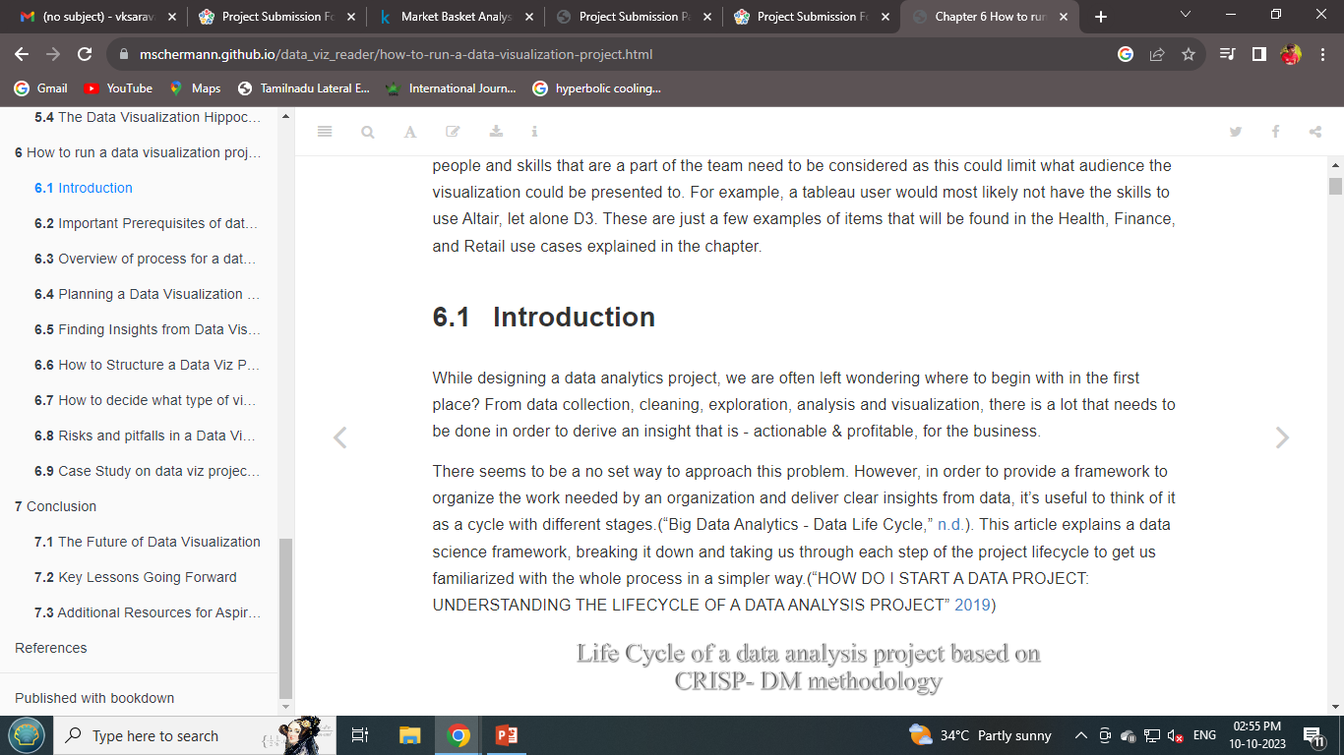
introduction

Slide 3
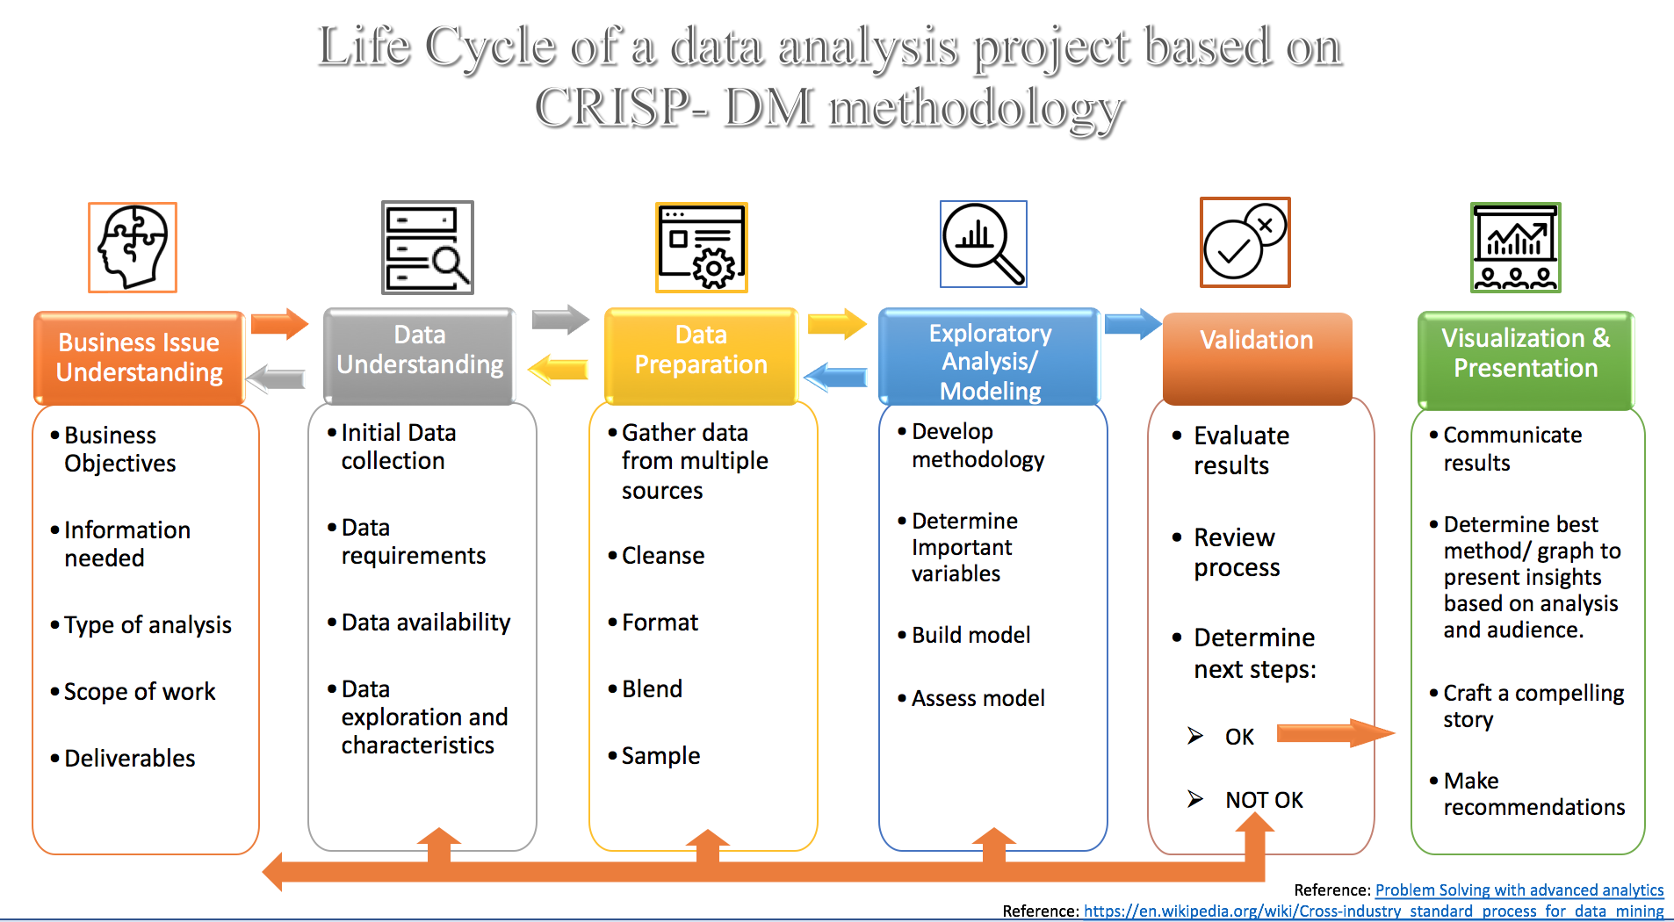
Life cycle of a data analysis

Slide 4
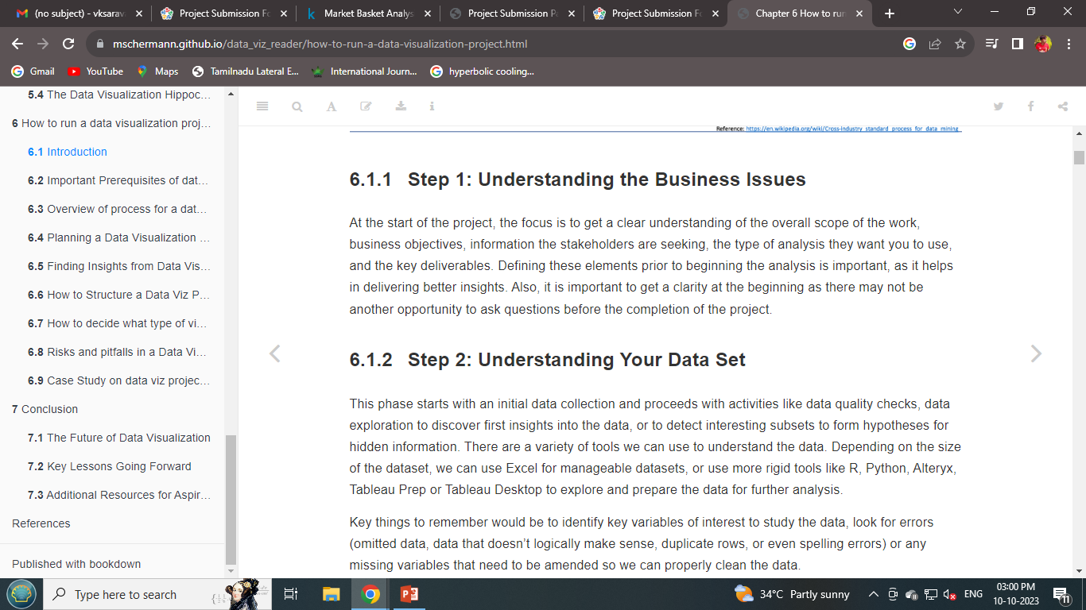
Steps of visualization

Slide 5
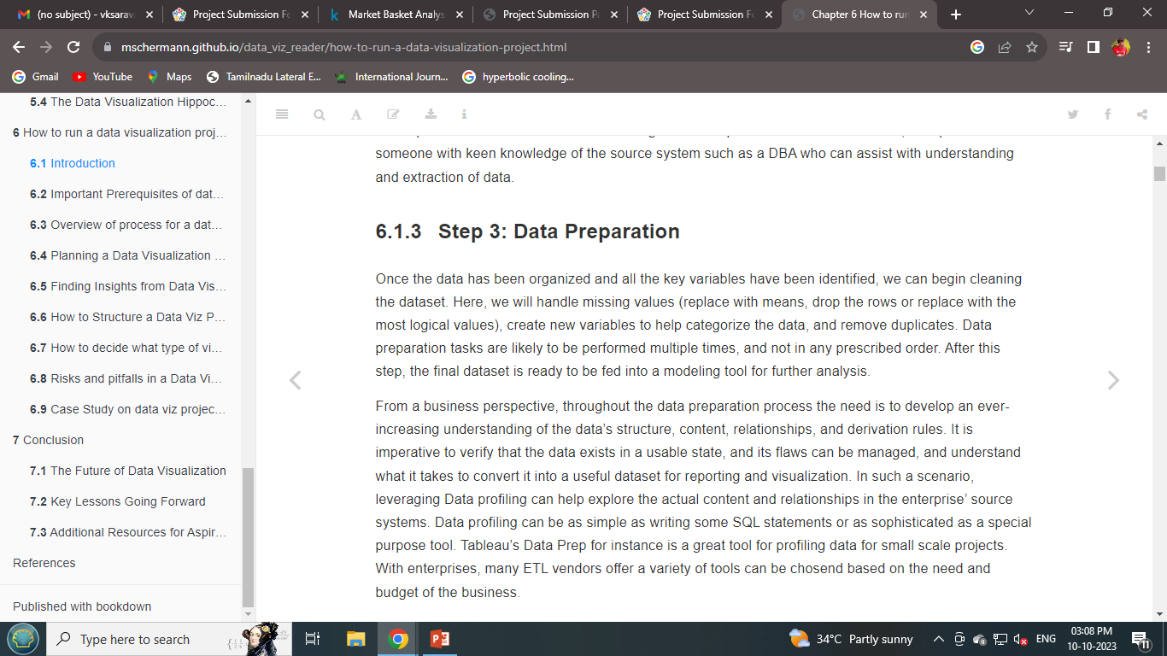

Slide 6
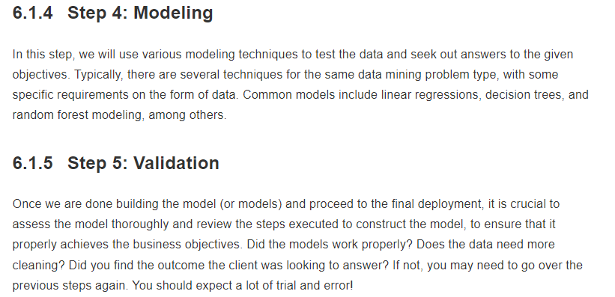

Slide 7
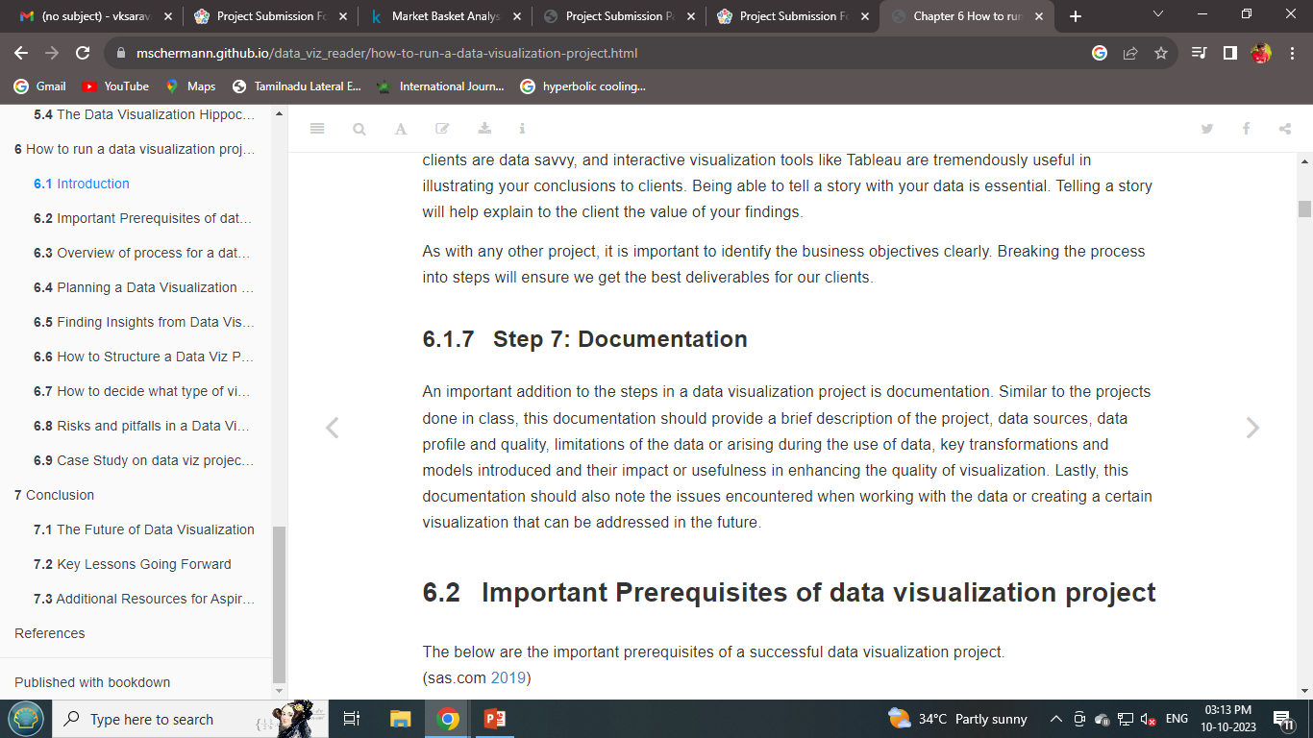

Slide 8
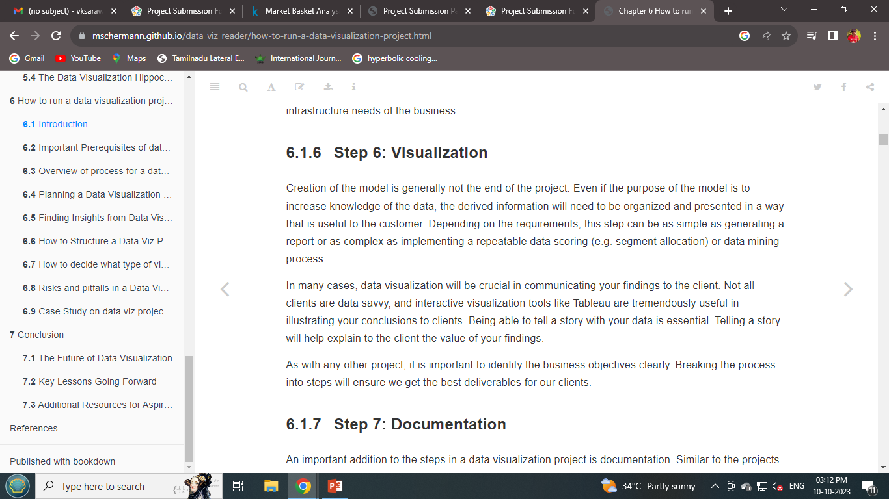

Slide 9
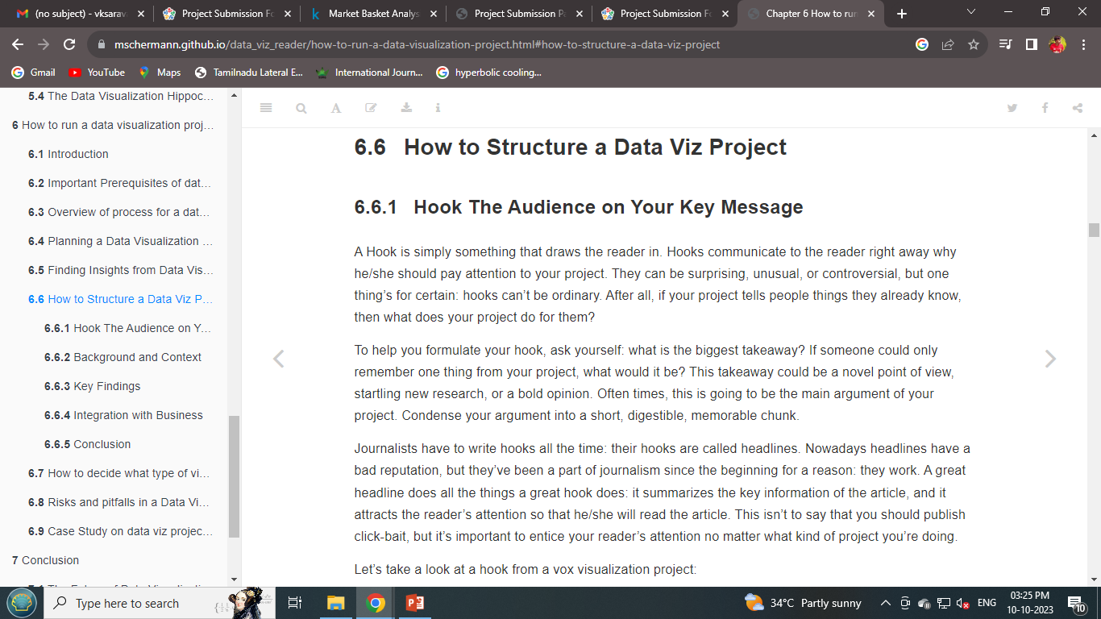
How to structurew od data viz project

Slide 10
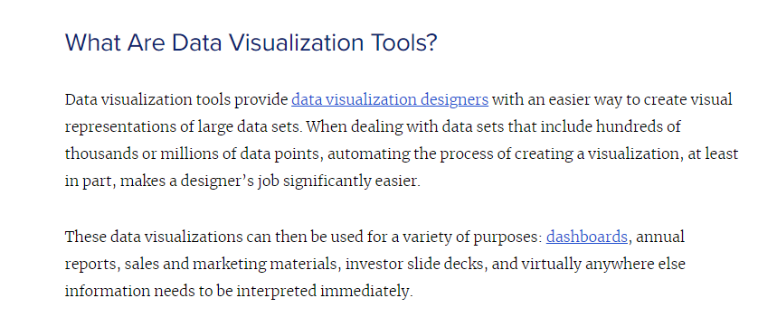
Visualization tools

Slide 11
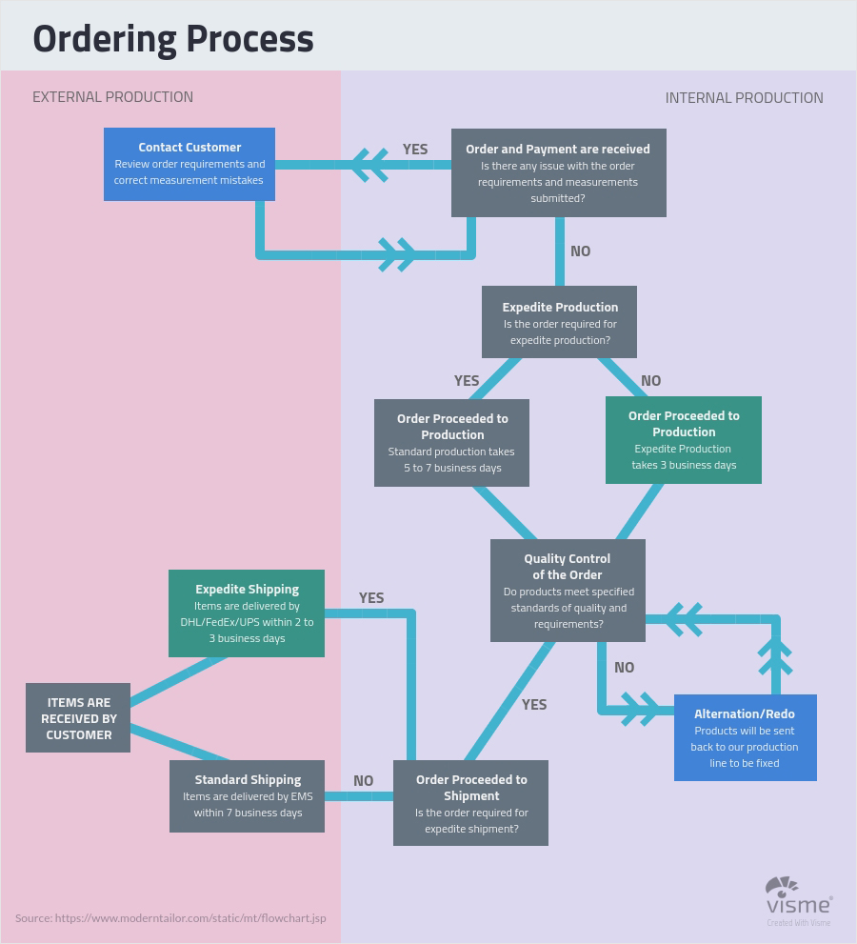
Ordering process

Slide 12
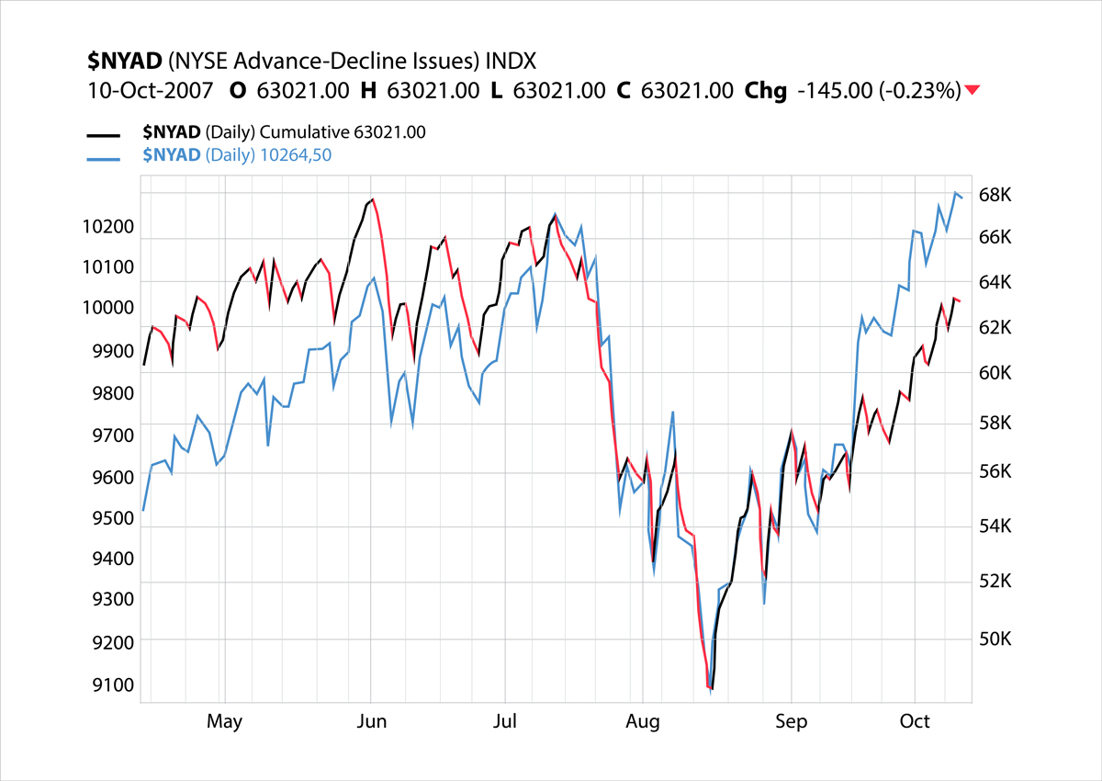
Stock charts

Slide 13
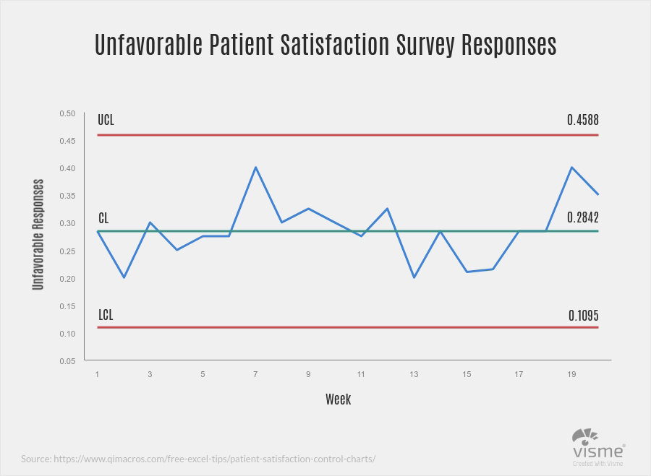
Survey responses

Slide 14
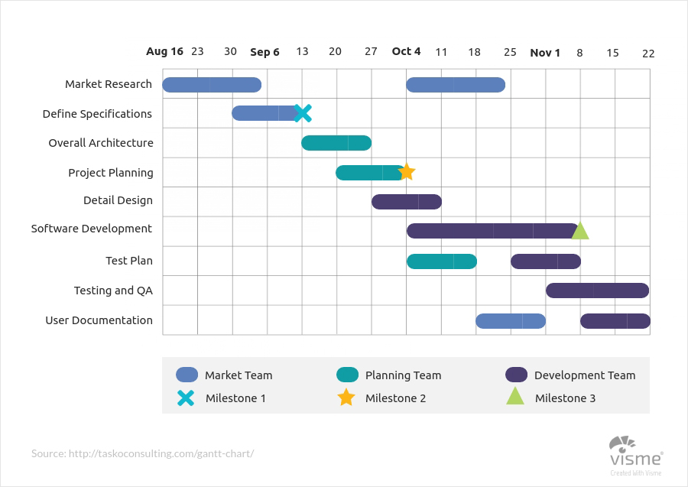
Gantt charts

Slide 15
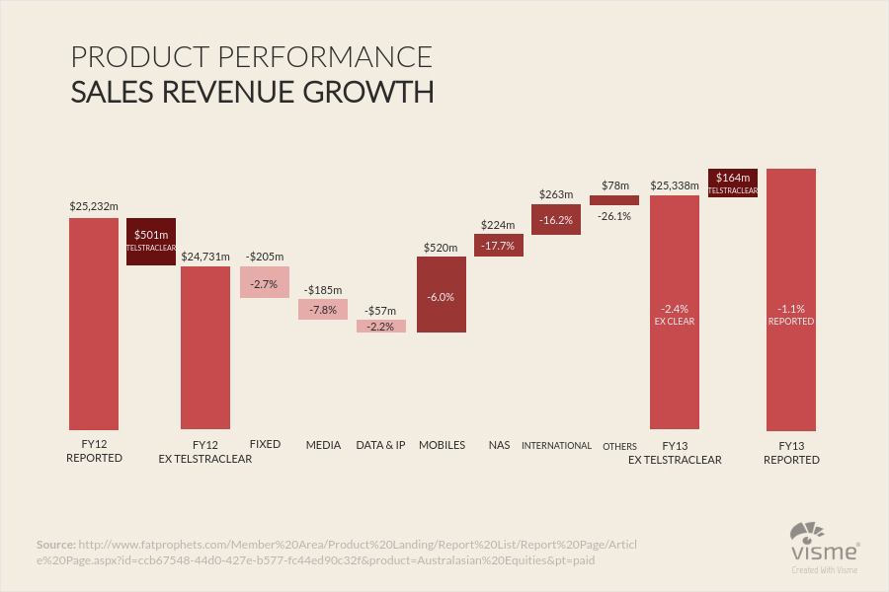
Salers revenue growth

Slide 16
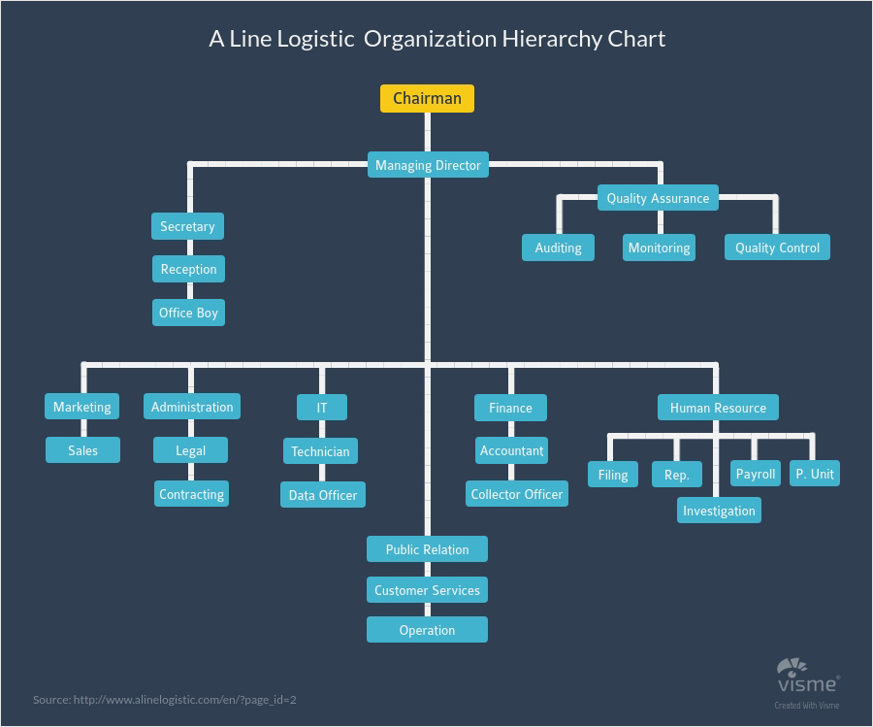
Hierearchy chart

Slide 17
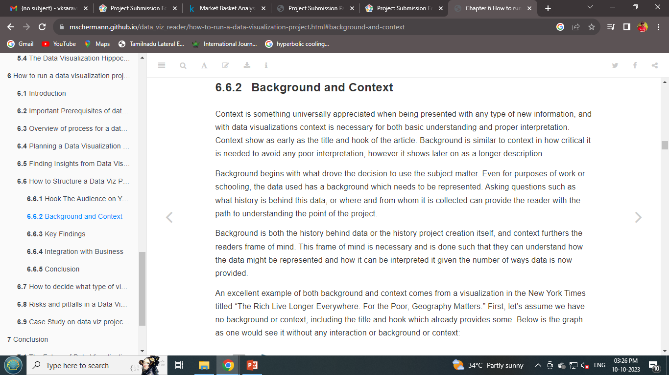
Background context

Slide 18
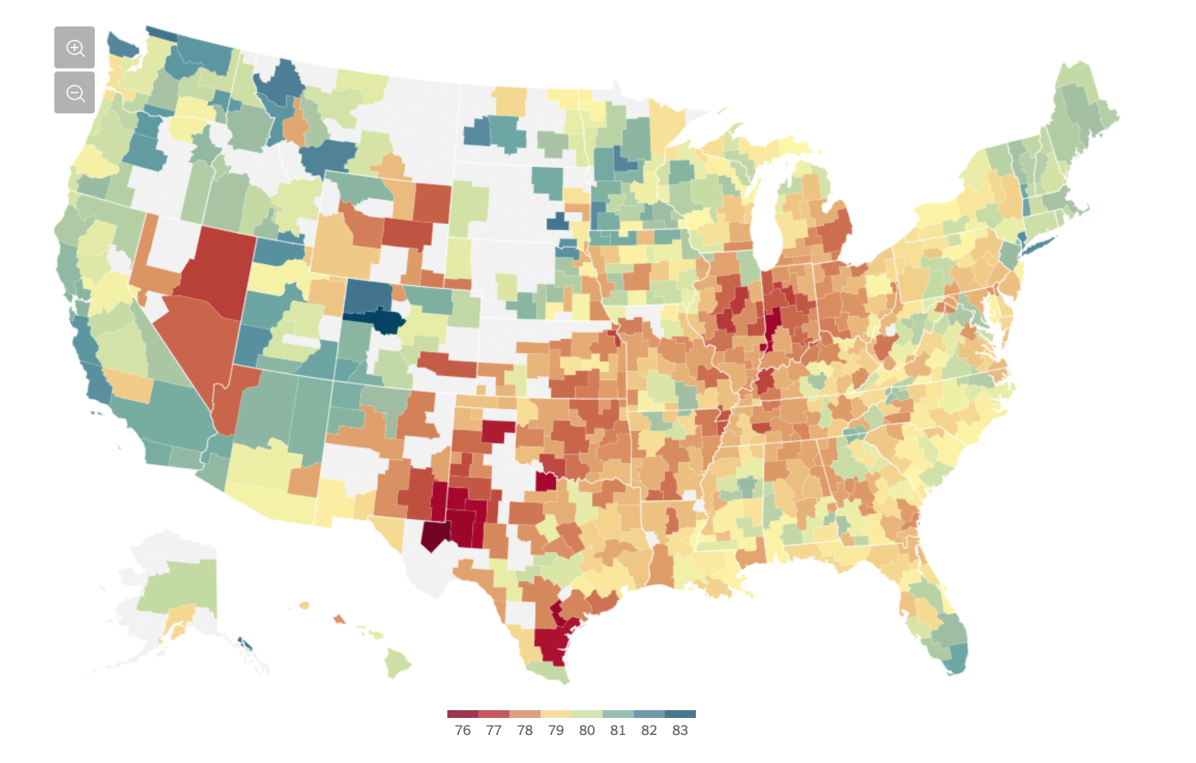
Background context

Slide 19
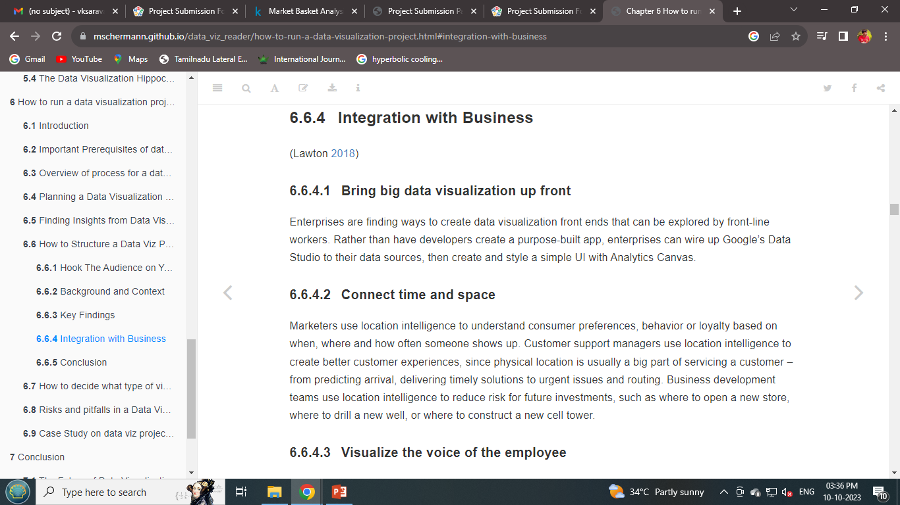
Integration with business

Slide 20

PRPARED BY P.PRITHVI RAJ.B.E(ECE) MRK INSTITUTE OF TECHNOLOGY

